Slide 1
SB4. Students will assess the dependence of all organisms on one another and the flow of energy and matter within their ecosystems.
Element c. Relate environmental conditions to successional changes in ecosystems.
EQ: How do ecosystems change over time?

Slide 2
Ecological Succession
Definition: The long term process of natural vegetation communities changing.
Often follows a predictable pattern.
There are two types of succession: Primary and Secondary

Slide 3
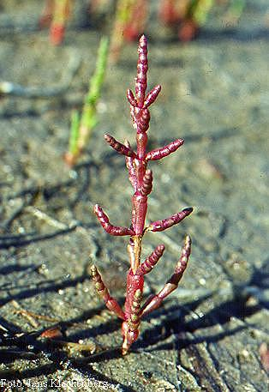
Pioneer Species
The first type of organism to start growing after an ecological disturbance is called a pioneer species.
They are often very hardy plants that can survive in full sun, poor soil, or even bare rock. Think “weeds.”

Slide 4
Primary vs. Secondary
Starts out with bare rock; no soil
Pioneer species are usually lichens, followed by moss
Ex: bare rock on a mountainside; lava flow
Starts when an existing ecosystem experiences a disturbance
Pioneer species are small annuals, followed by shrubs and trees
Ex: clear cutting a forest; wildfire

Slide 5
What is a lichen?
An organism consisting of an outer fungal body enclosing photosynthetic algae.
The fungus provides a structure for the algae to live in and the algae provide food for the lichen through photosynthesis.

Slide 6
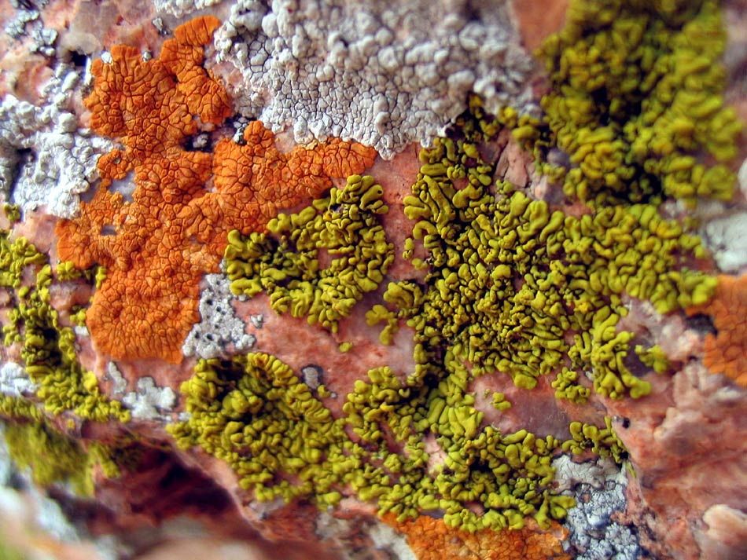
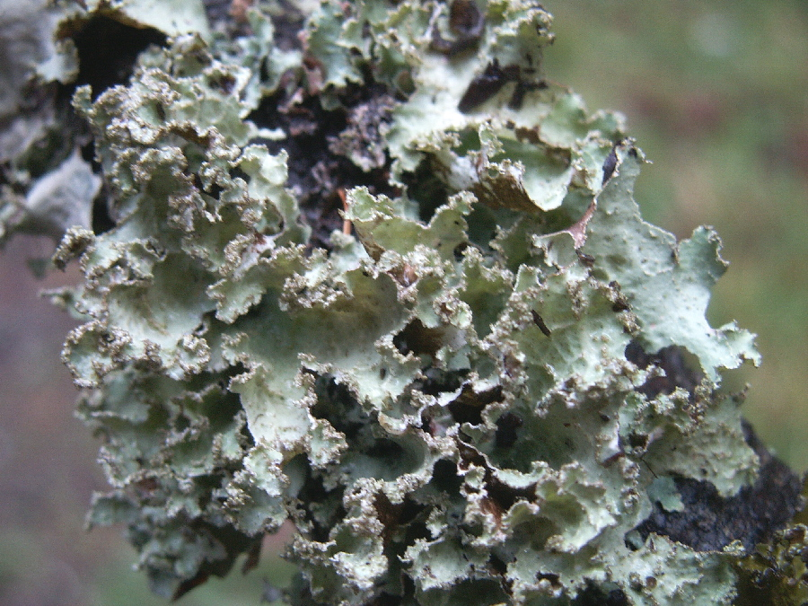
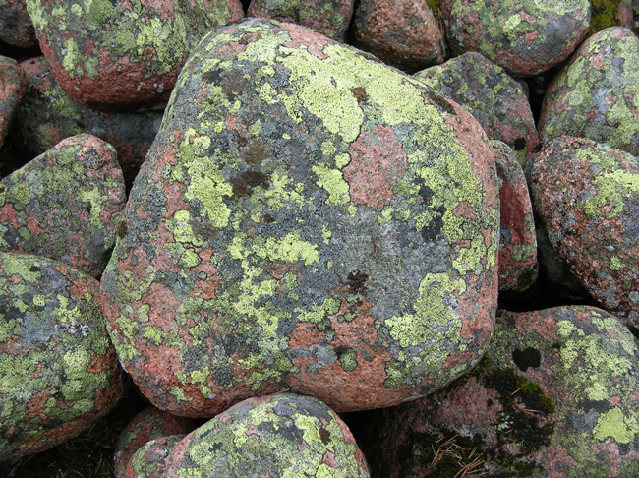
Lichens

Slide 7
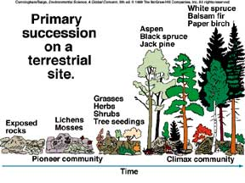

Slide 8
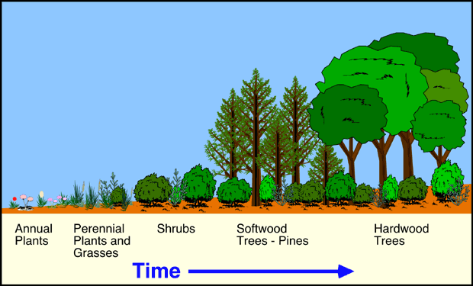
Secondary Succession

Slide 9
Growing a Climax Community
Pioneer species can tolerate sun, and provide some shade for shrubs to grow.
The shrubs provide enough cover for pine seedlings to grow.
Once the pine trees have matured, shade-tolerant tree species (like oaks) begin to grow and mature.
The climax community is the final, stable community that continues to exist until the next disturbance.

Slide 10
