Slide 1
SCIENTIFIC METHOD
A logical and systematic problem solving process

Slide 2
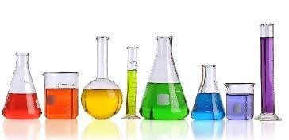
WHAT IS SCIENCE?
A process and way of learning
Verb, not a noun. Action, not a thing.
Science allows us to test, challenge and question ideas.

Slide 3
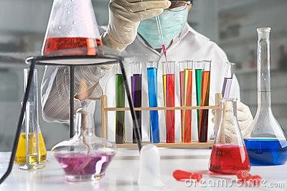
SCIENTIFIC METHOD
The scientific method is….
A logical and organized series of steps to gather information in order to answer questions about the natural world.

Slide 4
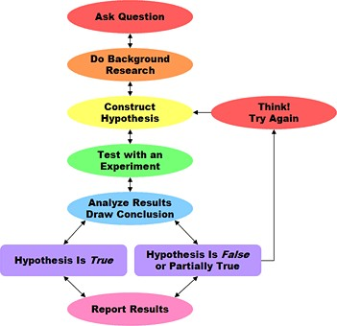
SCIENTIFIC METHOD
The steps……
✴ Ask Question & Collect Information
Form a Hypothesis
✴ Test the Hypothesis / Perform Experiment
✴ Collect, Record & Analyze Data
✴ Draw Conclusions and Share Findings
If needed, do more investigation!

Slide 5
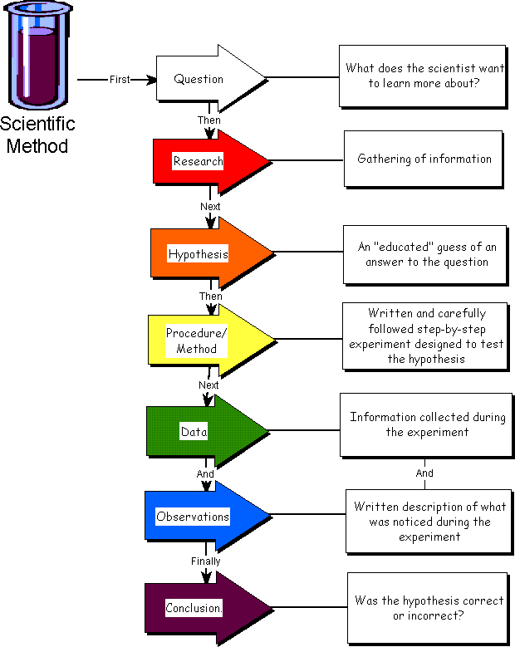
SCIENTIFIC METHOD
What the scientific method looks like on paper…..

Slide 6
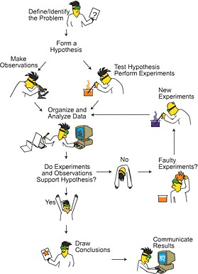
SCIENTIFIC METHOD
What the scientific method looks like in
real life…….

Slide 7
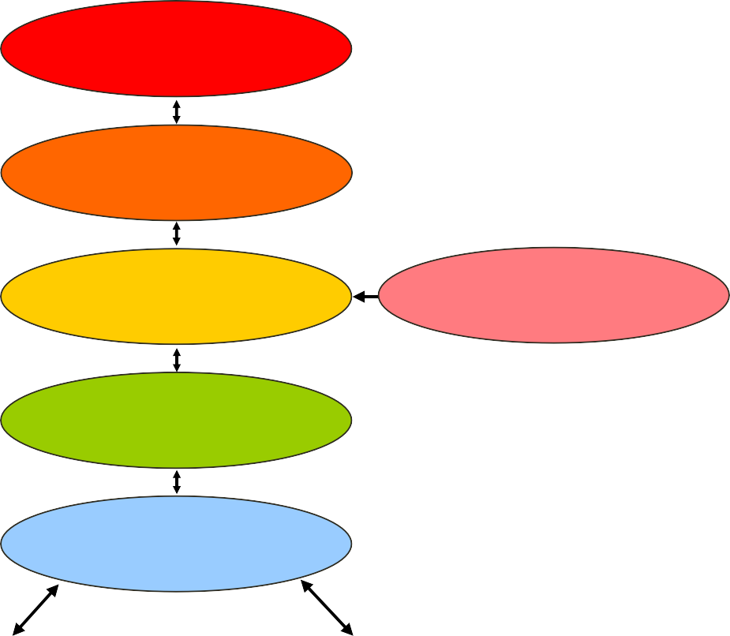
SCIENTIFIC METHOD
Let’s break each of these steps down into their individual components:
Ask Question
Do Background
Research
Construct Hypothesis
Think!
Try Again
Test with an
Experiment
Analyze Results Draw Conclusion
Hypothesis is True
Hypothesis is False
or Partially True
Report Results

Slide 8

SCIENTIFIC METHOD
An organized way of learning about the natural world
1. Ask a question and collect information
2. Form a Hypothesis
3. Test the Hypothesis / Experimental procedure
4. Collect, Record & Analyze Data
5. Draw conclusions & Communicate Findings

Slide 9



SCIENTIFIC METHOD
1.Ask a question and collect information
Questions arise from scientific inquiry
  Inquiry….thinking about something!
Inquiry begins with observations
  Observation: a direct method of gathering information
The processing of information leads to inferences
  Inference: logical conclusions drawn from previously collected information (observations)

Slide 10

SCIENTIFIC METHOD
Ask a question and collect information
✴ So why ask questions? To learn something!
✴ What if you observe that your neighbors flowers grow much better than your flowers…
  Observations: taller, fuller, more fragrant, more brightly colored
  Inference: your neighbor must take better care of their flowers.

Slide 11

SCIENTIFIC METHOD
1.Ask a question and collect information
These observations and inferences lead us to ask questions and collect information…
What must I do in order for my flowers to grow better?
Then you begin collecting background information on gardening and your ready to form your hypothesis!

Slide 12
SCIENTIFIC METHOD
An organized way of learning about the natural world
1. Ask a question and collect information
2. Form a Hypothesis
3. Test the Hypothesis / Experimental procedure
4. Collect, Record & Analyze Data
5. Draw conclusions & Communicate Findings

Slide 13

SCIENTIFIC METHOD
2.Formation of a hypothesis
A scientific and testable explanation based on observations and collected information
✴ So basically, an inference!
Typically written in “If……then……” format
  If I do this, then this will happen.
  If I put fertilizer on my plants, then they will grow bigger

Slide 14
SCIENTIFIC METHOD
2.Formation of a hypothesis
Why form a hypothesis?
The support or rejection of a hypothesis determines the validity of an experiment
  If the data supports the hypothesis: the investigation is
accepted as valid
  If the data rejects the hypothesis: the hypothesis is rejected and additional investigations are conducted
So is a “wrong” hypothesis still a good hypothesis?

Slide 15
SCIENTIFIC METHOD
An organized way of learning about the natural world
1. Ask a question and collect information
2. Form a Hypothesis
3. Test the Hypothesis / Experimental procedure
4. Collect, Record & Analyze Data
5. Draw conclusions & Communicate Findings

Slide 16


SCIENTIFIC METHOD
3.Experimental procedure- designed to test the hypothesis
Split subjects you are testing into groups:
Experimental Group- Contains the changed variable.
Control Group-NO changed variable. The “comparison group”
Constants- other variables that remain the same in all groups.
Experimental Group
Fertilizer
Control Group No Fertilizer

Slide 17

SCIENTIFIC METHOD
Variable-any factor in experiment that could be changed
Fertilizer, sunlight, water, etc
Independent variable- factor in experiment that is changed
by the scientist
  fertilizer
Dependant variable - factor that is measured by the scientist
  height and ?
Remember, only test ONE manipulated variable at a time, everything else should remain constant!

Slide 18
SCIENTIFIC METHOD
Must be a controlled, reproducible procedure
Testing effects of
only ONE manipulated
variable
Other scientists
need to be able to reproduce it and find same results.

Slide 19
EXPERIMENTAL SET UP
EXPERIMENT
EXPERIMENTAL
GROUP
Difference is the
Independent variable
CONTROL
GROUP
Check the results
in time
Compare the
Dependent variable
Check the results
in time

Slide 20
SCIENTIFIC METHOD
An organized way of learning about the natural world
1. Ask a question and collect information
2. Form a Hypothesis
3. Test the Hypothesis / Experimental procedure
4. Collect, Record & Analyze Data
5. Draw conclusions & Communicate Findings

Slide 21

SCIENTIFIC METHOD
4. Collect and record data
As scientists test their hypotheses, they gather data.
Data – information gained from observations.
Data can be qualitative or quantitative
Qualitative data -physical traits (qualities) that can be described
Quantitative data -measurements (quantities) that can
be taken

Slide 22
SCIENTIFIC METHOD
4. Collect and record data
Quantitative Data
Examples: time, temperature, length, mass, area, volume, density, etc
NUMBERS
Qualitative Data
Examples: descriptions of what our senses collect.
Interpreted differently by different people
✴ Which type of data would you consider “stronger?”

Slide 23


SCIENTIFIC METHOD
Common measurement system
Metric system or (SI)- a measurement system used worldwide by scientists based on multiples of 10
Mass-grams (g)
Volume-liters (L)
Distance-meters (m)
Temperature- Kelvin (K) or Celsius (^{O}C)

Slide 24


Scientific Method Results
Qualitative?
Quantitative?
Experimental Group fertilizer
Control Group no fertilizer

Slide 25
SCIENTIFIC METHOD
Collect and record data
Analyze the data and state the results
Pictures, tables, graphs
  Make patterns more easily visible
  Trends noticed
State the results
  Should be a summary, not a conclusion

Slide 26
SCIENTIFIC METHOD
An organized way of learning about the natural world
1. Ask a question and collect information
2. Form a Hypothesis
3. Test the Hypothesis / Experimental procedure
4. Collect, Record & Analyze Data
5. Draw conclusions & Communicate Findings

Slide 27

SCIENTIFIC METHOD
5.Conclusions
A good conclusion…
Restates the results
✴ Addresses the hypothesis
Forms a conclusion

Slide 28
SCIENTIFIC METHOD
Conclusions
✴ Hypothesis is either supported or rejected. NEVER “PROVEN!”
✴ If supported
  Draw conclusions, publish findings, further testing
✴ If rejected
  Hypothesis is modified and tested again
✴ Can be partly supported
Either way, findings are always useful!!!

Slide 29
SCIENTIFIC METHOD
5.Conclusions
✴ After you state the results, the conclusion is the “therefore…”
Example:
✴ According to the results, the flowers given fertilizer consistently grew taller and fuller; therefore, my hypothesis is supported. The use of fertilizer will lead to better growing flowers.

Slide 30

COMMUNICATE RESULTS
Results of experiments are communicated formally in written reports published in scientific journals.
Other scientists can analyze the design and conclusions or repeat the experiment
themselves.
Repeatability is a good check on correctness of scientific conclusions.

Slide 31
NOW LET’S PRACTICE!

