Slide 2
Ecology
Gr. “oikos” means house
Gr. “ology” means the study of

Slide 3
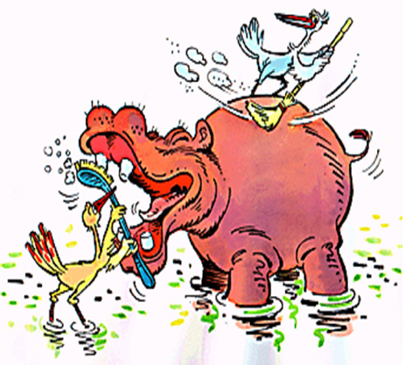
What is Ecology?
The study of the “house” of nature
The study of relationships between organisms, populations, communities and the environment

Slide 4
Ecosystem Structure
Biotic Factors (“bio” living)
Parts of an ecosystem that are alive or once were alive (i.e. organisms and their products)
Examples: bacteria, archaea, protists, fungi, plants, animals, feces, oil, fossils, coal
Abiotic Factors (“a” not, “bio” living)
Parts of an ecosystem that were never alive
Examples: rocks, soil, water, light, air, temp

Slide 5
Find the Biotic & Abiotic Factors

Slide 6
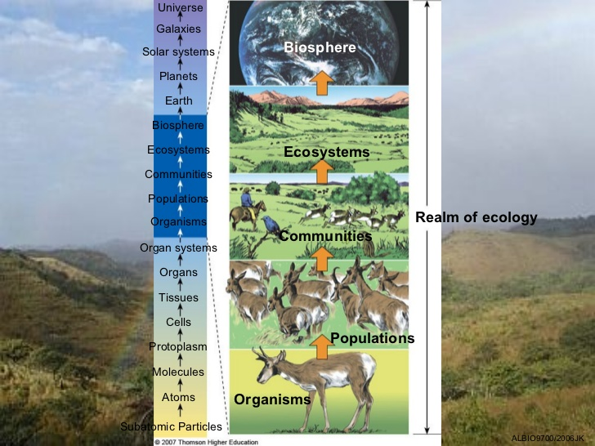
Levels of Organization
Individual
Population
Community
Ecosystem
Biome
Biosphere

Slide 9
What is an Individual?
An individual is a single organism

Slide 10
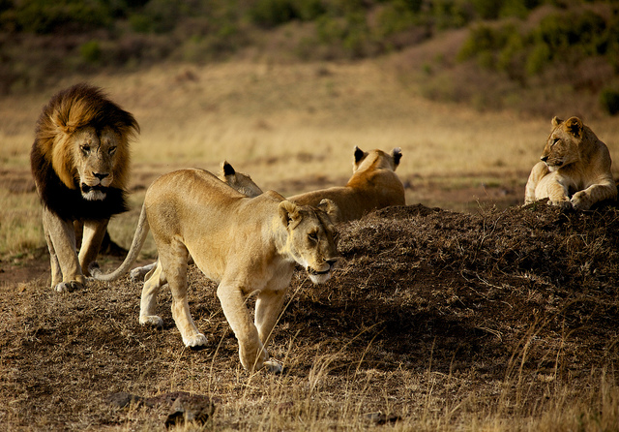
What is a Population?
A population is all the members of one species in an area at one time

Slide 11
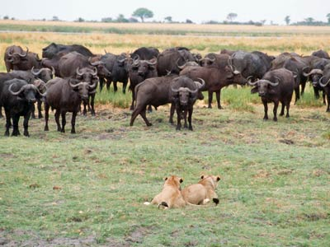
What is a Community?
A community is all of the organisms in a particular area at one time.

Slide 12
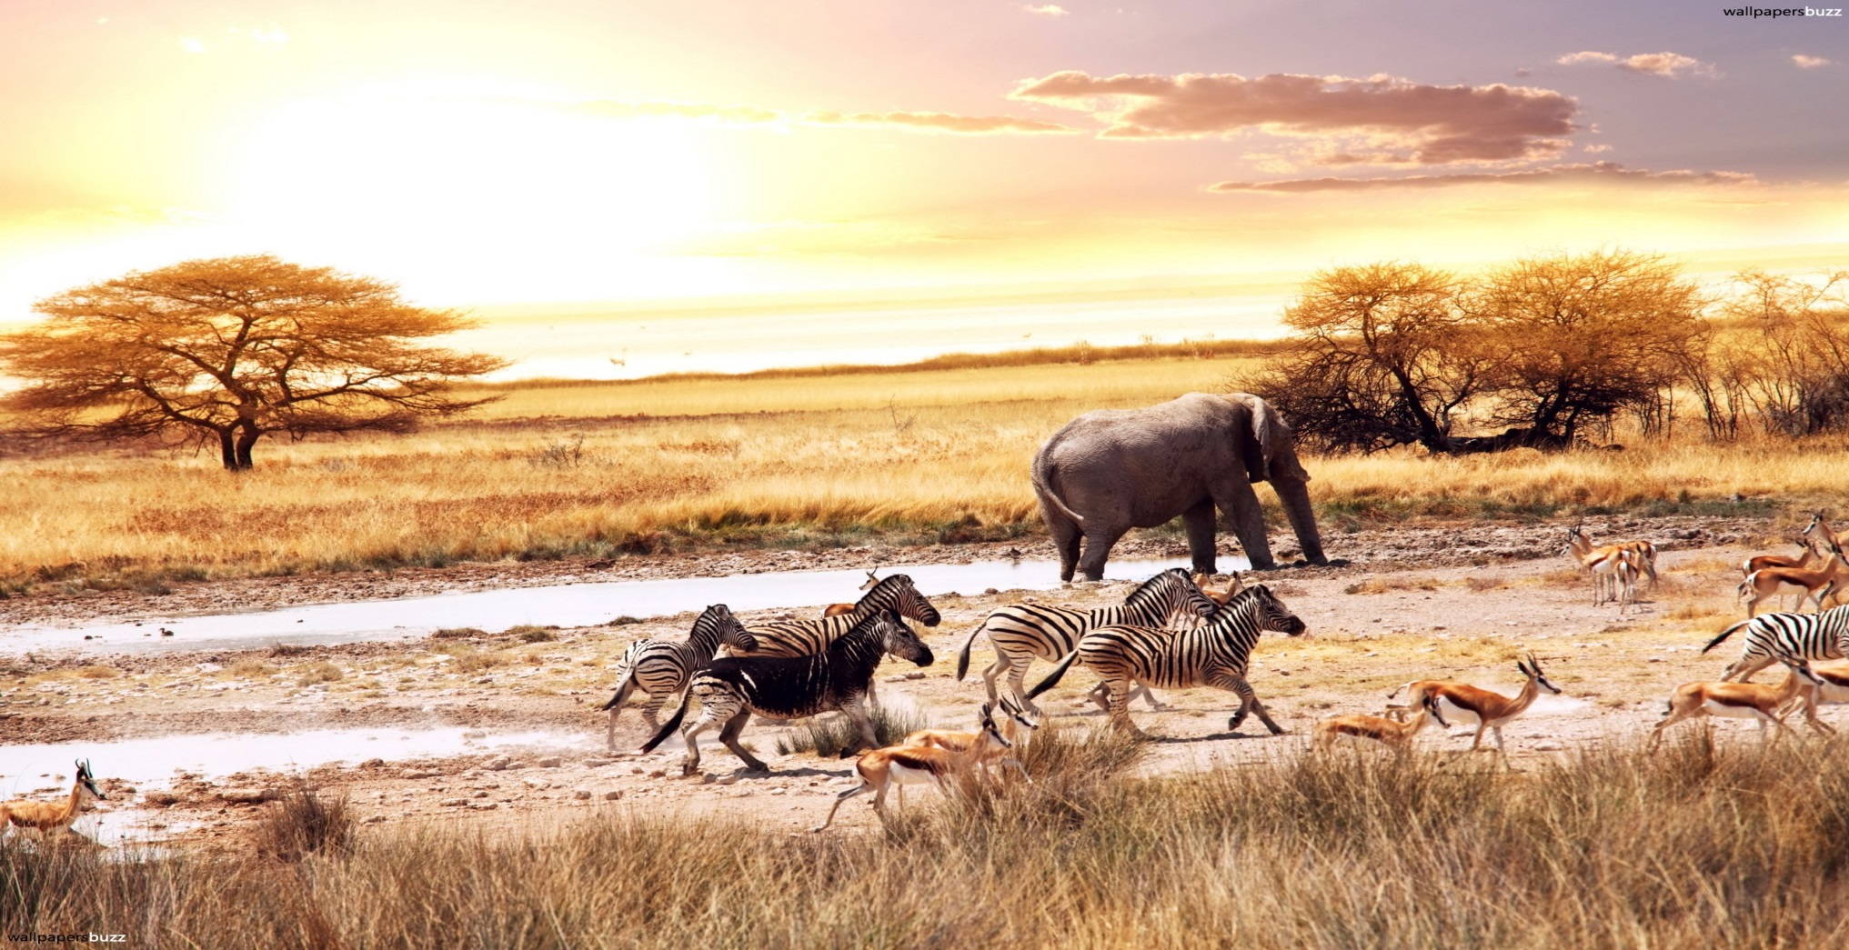
What is an Ecosystem?
An ecosystem includes all of the biotic factors and all of the abiotic factors in a specific area

Slide 13
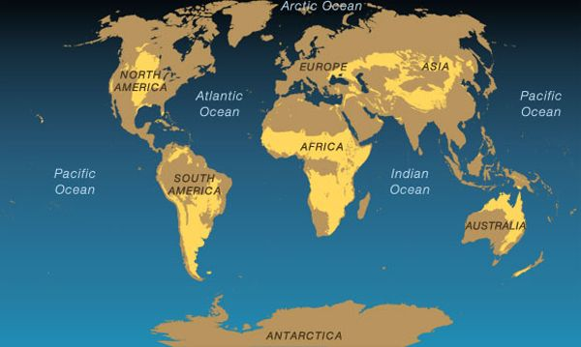
What is a Biome?
A biome is a large region characterized by a specific climate and certain kinds of plants and animals, e.g. savanna, desert, rainforest

Slide 14
Map of Earth’s Major Biomes

Slide 15
Interspecies Interactions
Interactions between the different species in a community
Competition (-) (-) negative/negative relationship
Predation (+) (-) positive/negative relationship
Traditional Predation
Herbivory
Parasitism
Mutualism (+) (+) positive/positive relationship
Commensalism (+) (0) positive/no effect relationship

Slide 16
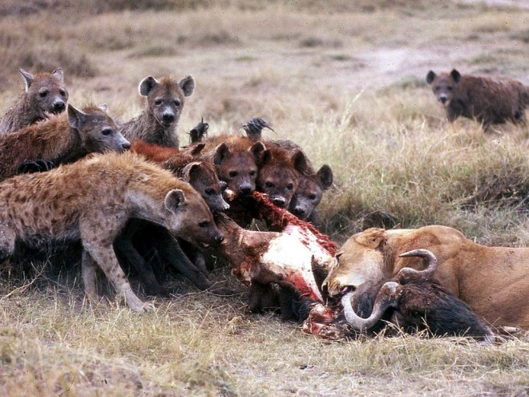
Competition
Often species must compete for resources.

Slide 17
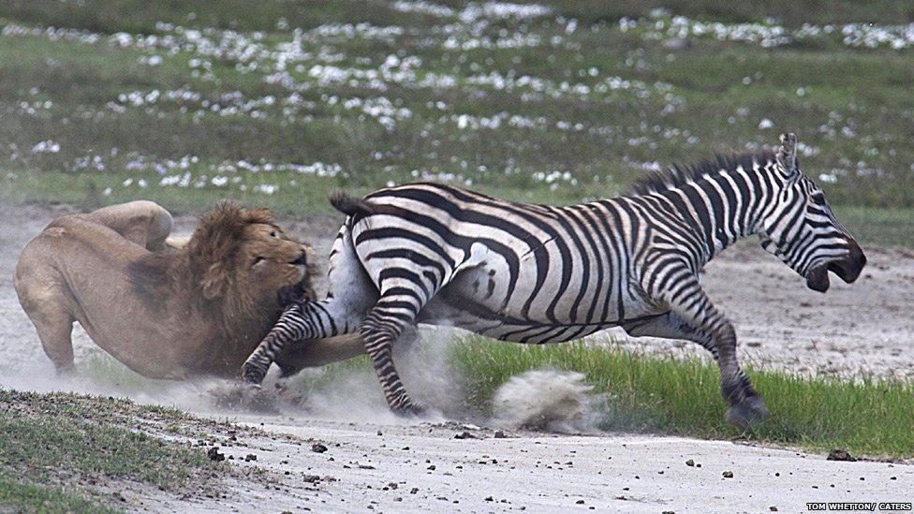
Predation
The act of one organism killing another for food

Slide 18
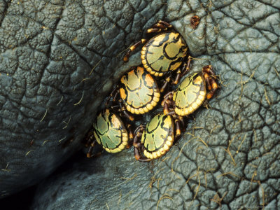
Parasitism
One organism benefits and the other is harmed, but usually not killed. One organism feeds on another organism, who is called the host.

Slide 19
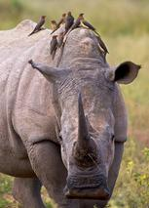
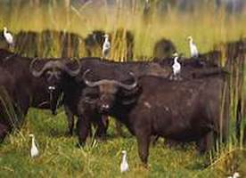
Symbiosis (“sym” together “bio” life “sis” the state of)
A relationship in which two species live in close association with each other

Slide 20
Mutualism
A symbiotic relationship in which both species benefit

Slide 21
Commensalism
A symbiotic relationship in which one species benefits and the other is neither harmed nor helped.

