Slide 2
Ecology
Populations & Energy Flow

Slide 3
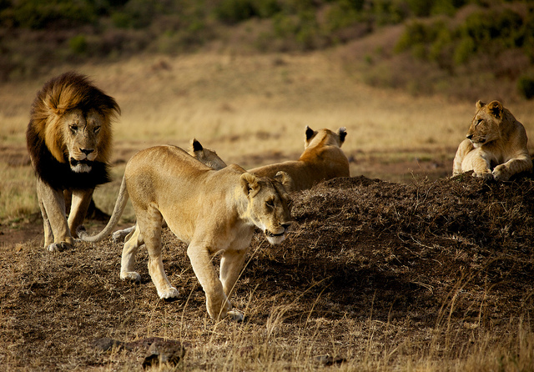
What is a Population?
A population is all the members of one species in an area at one time

Slide 4
Population Dynamics
The study of changes in population size
3 causes of change:
Birth Rate
Death Rate
Migration (immigration, emigration)
(Birth Rate + Immigration) – (Death Rate + Emigration) = Change in population size

Slide 5
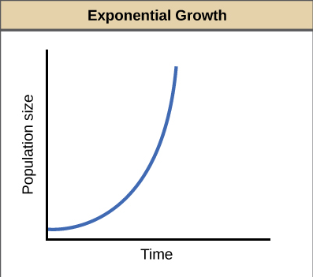
Exponential Growth
Exponential growth occurs when a population continuously grows at an increasing rate
Represented by a ‘J’ curve on a graph

Slide 6
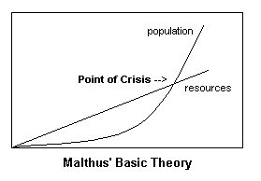
No population can grow indefinitely. Why? Remember Thomas Malthus & Darwin?

Slide 7
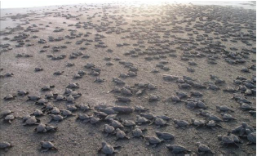
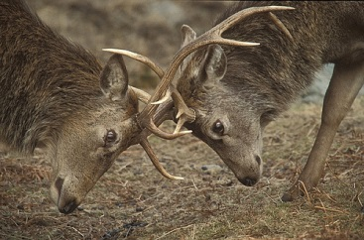
Organisms tend to produce more offspring than an ecosystem can support
Limited Resources + Too many organisms = Competition

Slide 8
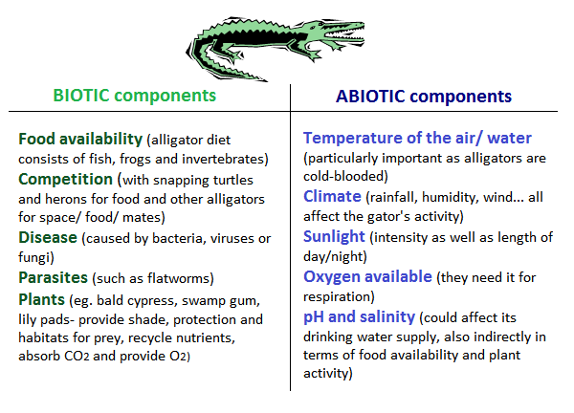
Limiting Factor
A biotic or an abiotic factor that determines the maximum size of a population

Slide 9
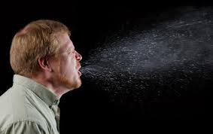
Types of Limiting Factors
Density-dependent limiting factors
These factors have a larger effect on the population the larger it gets
Examples:
Disease
Competition
Predation

Slide 10
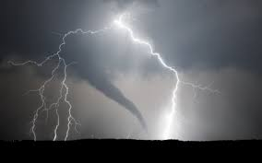
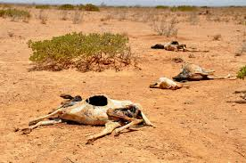
Density-independent limiting factor
Factors that affect a population equally no matter how large it is.
Examples
Climate
Drought
Storms

Slide 11
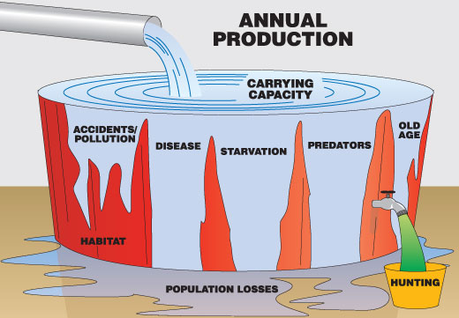
Carrying Capacity
Limiting factors create a barrier to population growth called the carrying capacity.
The carrying capacity represents the maximum population size that a given habitat can support.

Slide 12
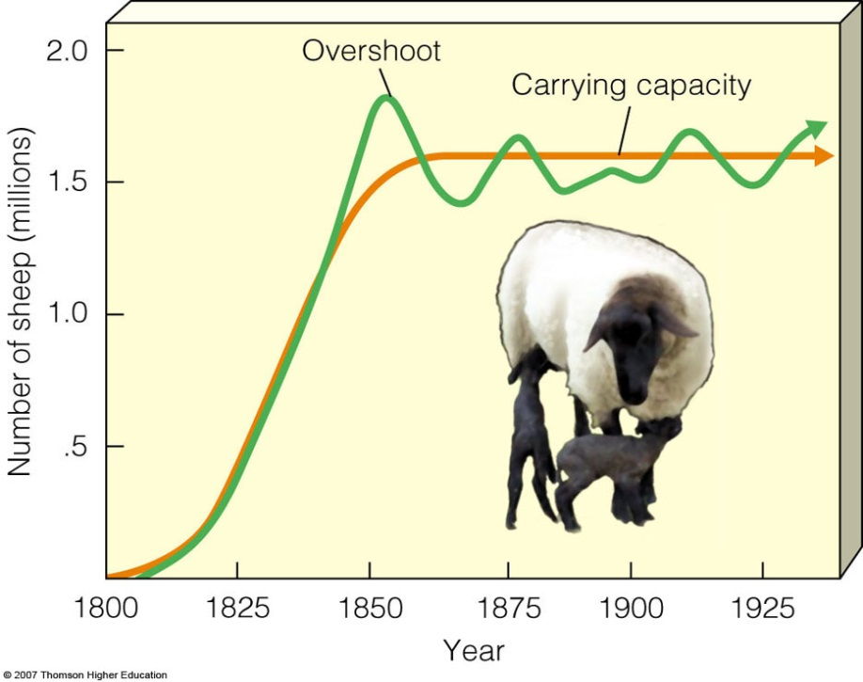
Population Growth Cycle
1. Population overshoots Carrying Capacity
2. Population has a dieback/crashes
3. Carrying Capacity is reached

Slide 14
Predator Prey Oscilitions

Slide 15
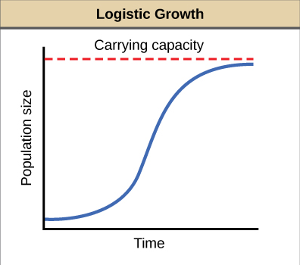
Logistic Growth
Happens when a population size levels off.
A population grows to a maximum, which depends on the carrying capacity
Represented by an ‘S’ curve on a graph

Slide 17
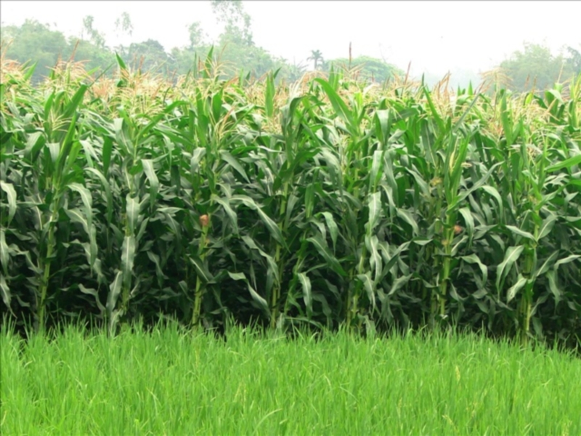
Energy Flow through Ecosystems
Organisms that produce their own energy through photosynthesis are called producers
Producers are autotrophs and the most common example are plants

Slide 18
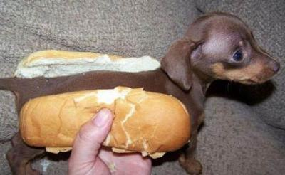
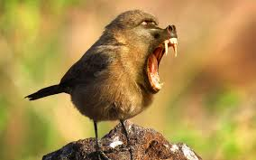
Organisms that cannot make their own energy are called consumers. They must eat other organisms to obtain energy.
Consumers are heterotrophs and a common example would be animals

Slide 19
Consumer Types
Consumers that only eat producers are called primary consumers.
Herbivores—eat only producers (e.g. plants)
Consumers that only eat other consumers are called secondary consumers.
Carnivores—only eat meat
Other consumers eat producers and consumers
Omnivores—eat plants & animals

Slide 20
Food Chain
Food chains show linear feeding relationships
Carnivore
Tertiary Consumer
Omnivore
Secondary Consumer
Herbivore
Primary Consumer
Plant
Producer

Slide 21
Food Web
Most animals rely on a variety of food sources. Food webs are a more detailed illustration of who’s eating whom.

Slide 22
Food webs are interconnected food chains showing feeding relationships in an ecosystem

Slide 23
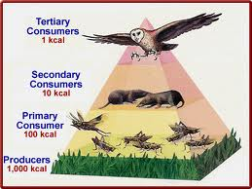
Energy Pyramids
Show available energy decreasing as one moves from one trophic level to the next on the pyramid

Slide 24
Ten Percent Rule
Only 10% of the energy at one trophic level is available to the next.

Slide 25
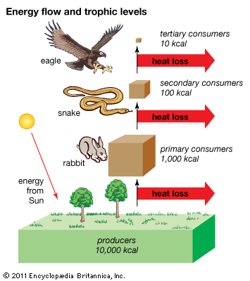
Why only ten percent?
Energy transfer is inefficient
Some energy is lost as heat

