Slide 1
What is Biology?
The study of life and living organisms

Slide 2
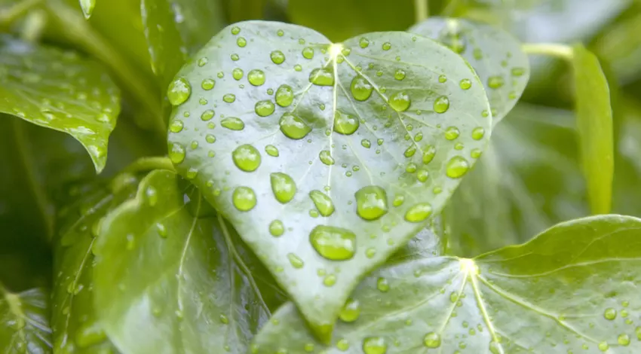
Characteristics of Life
All living things:
Made of one or more cells
Display organization
Grow and develop
Able to reproduce
Respond to stimuli
Require energy
Maintain homeostasis
Adapt to their environment

Slide 3
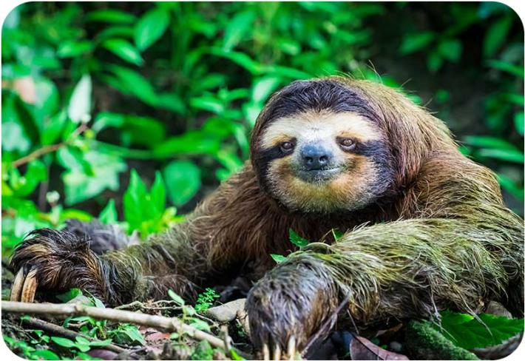
Characteristics of Life
Organism – anything that has, or once had, ALL characteristics of living things.

Slide 4
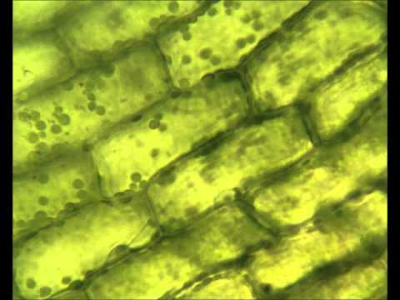
Characteristics of Life
All living things are made up of one or more cells.
The cell is the basic unit, or building block, of life.
Some organisms are unicellular, made of a single cell
Other organisms are multi-cellular, made of many cells
All cells contain genetic information (DNA).

Slide 5
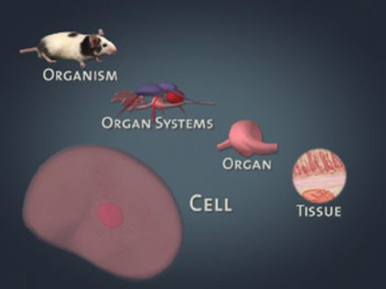
Characteristics of Life
All living things display organization
Each organized structure in an organism has a specific function
Atoms -> molecules -> organelles -> cells -> tissues -> organs -> organ systems -> organisms

Slide 6
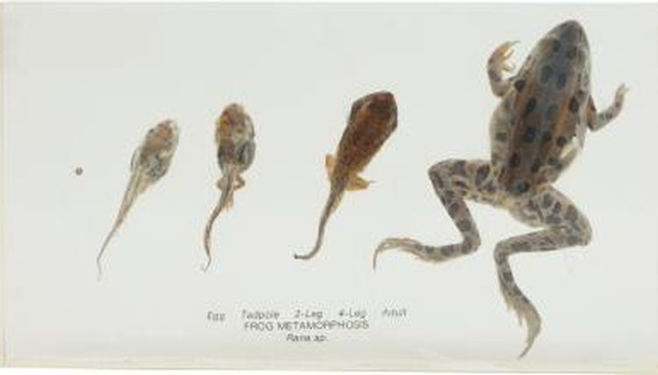
Characteristics of Life
All living things grow and develop
Growth – an increase in mass and/or size (i.e. getting bigger)
Develop – change in features or abilities
Ex: a bullfrog tadpole grows and develops into an adult bullfrog

Slide 7
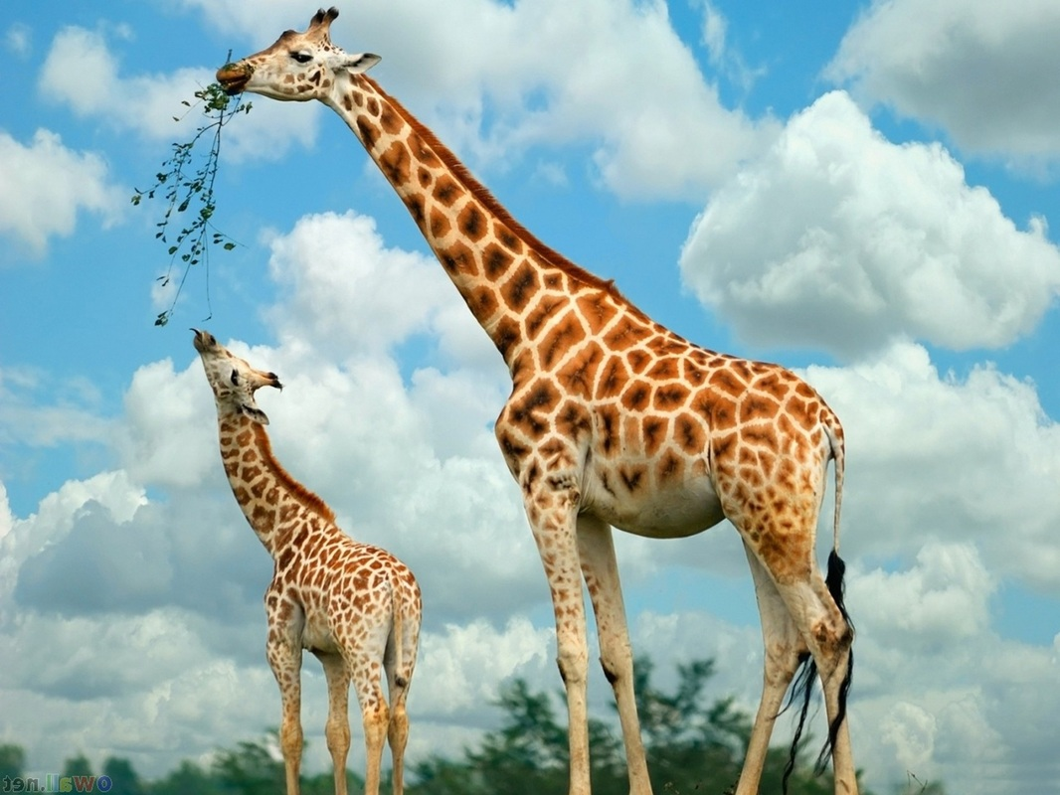
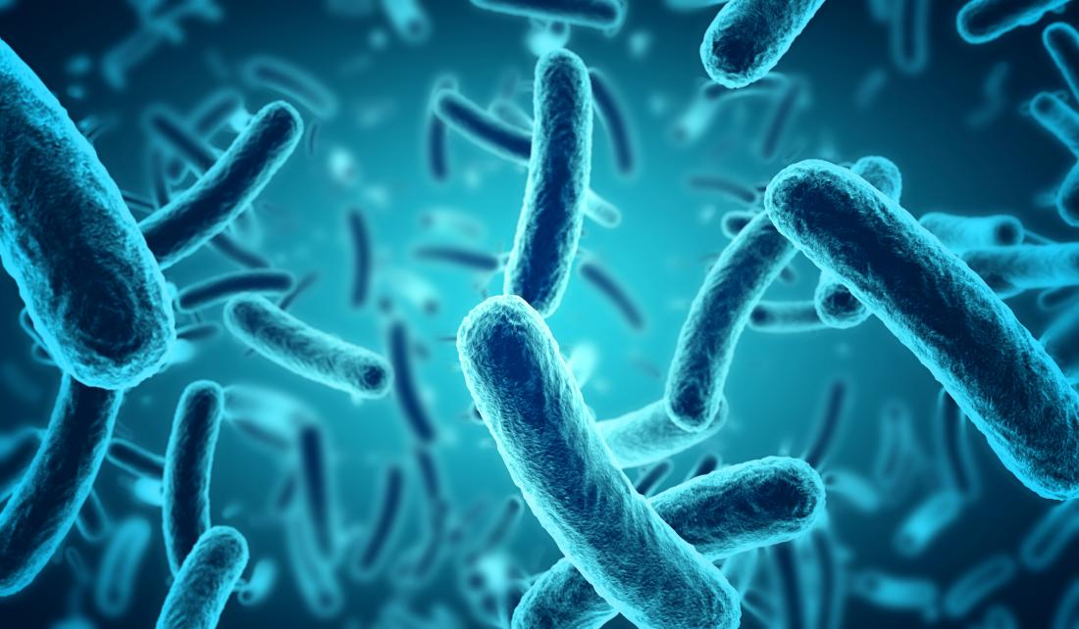
Characteristics of Life
All living things are capable of reproduction
Organisms produce offspring in order to pass genetic traits from generation to the next
Asexual vs. Sexual Reproduction
Asexual Reproduction – one parent, identical offspring
Sexual Reproduction – two parents, offspring are genetically different from parents

Slide 8
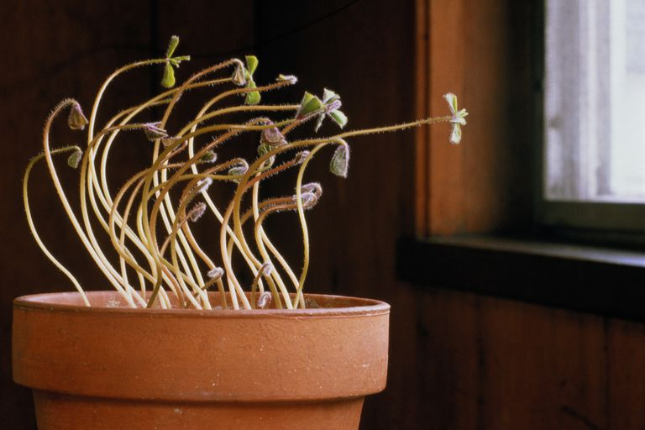
Characteristics of Life
All living things respond to stimuli
Living things will make changes in response to their environment
Stimulus – anything that causes some sort of reaction in an organism
Response – reactions to stimuli, can be internal or external

Slide 9
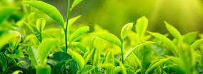
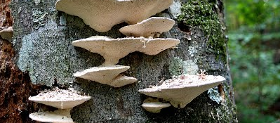
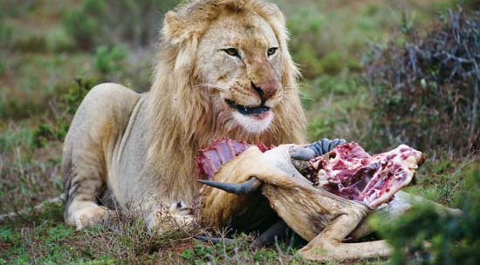
Characteristics of Life
All living things require energy
Energy is required for all of life processes and can be obtained in a variety of ways
Autotroph – uses energy from sun to make food
Heterotroph – consumes other organisms to obtain energy
Decomposer – breaks down dean organisms for energy

Slide 10
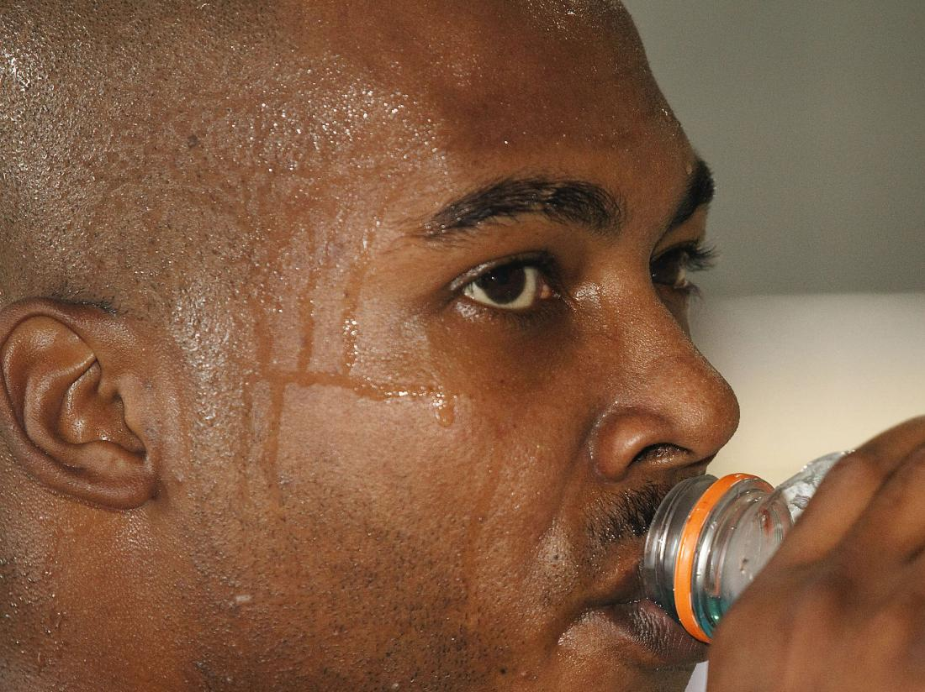
Characteristics of Life
All living things maintain homeostasis
Homeostasis – regulation of an organisms internal condition to maintain life
Waste removal, osmosis, thermal regulation, etc.

Slide 11
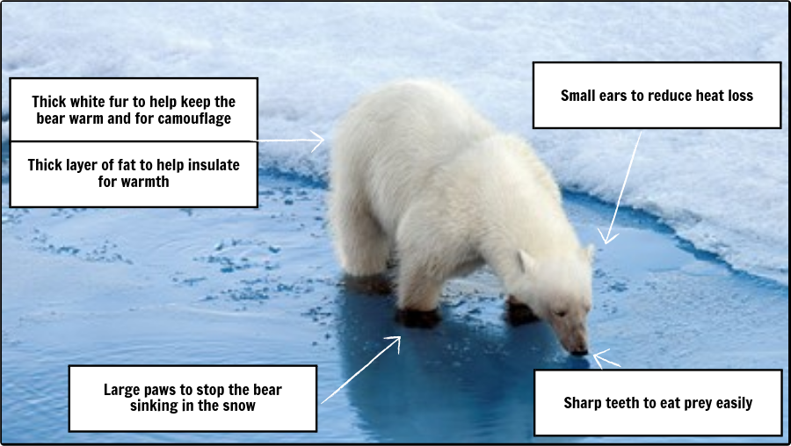
Characteristics of Life
All living things adapt to their environment
Adaptation – any inherited characteristic that benefits an organism in its environment
Adaptations help organisms survive!
A “strong” species is genetically varied

