Slide 1
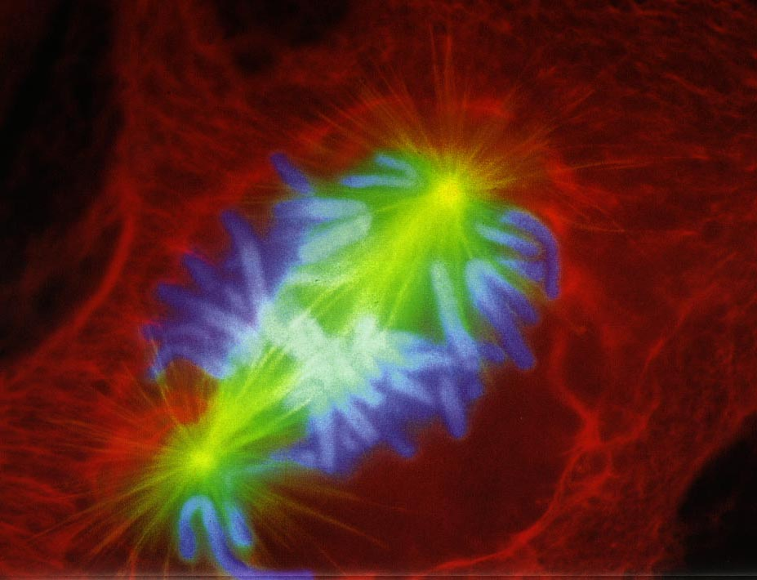
The Cell Cycle
Growth, Duplication & Division

Slide 2
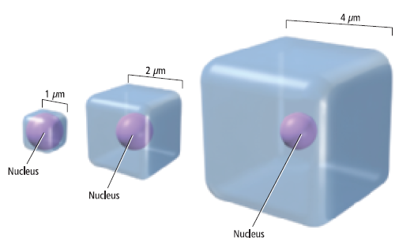
Cell Growth
A cell size is limited by its surface area (SA) to volume (V) ratio

Slide 3
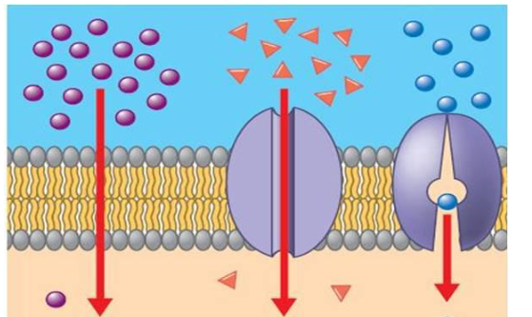
Surface Area to Volume Ratio
A cells SA is the area covered by its membrane
The cells ability to transport material is determined by its SA
A cells V is the area occupied by its cytoplasm (cytosol & organelles)
The cells need to transport material is determined by its V

Slide 4
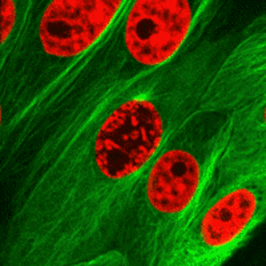
SA:V Determines Cell Size
As a cell grows its V increases faster than its SA
Once a cell reaches the point where its ability to transport materials (SA) cannot meet its need to transport materials (V) it will stop growing or it will divide
Notes:
A cells need to transport materials (V) increases at a faster rate than its ability to transport materials (SA)

Slide 5
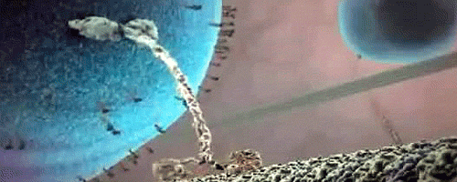
Cell Size & Transport
Once inside the cell, substances move by diffusion or by motor proteins pulling them along the cytoskeleton
Cells remain small because diffusion and cytoskeletal transportation over long distances is slow and inefficient

Slide 6
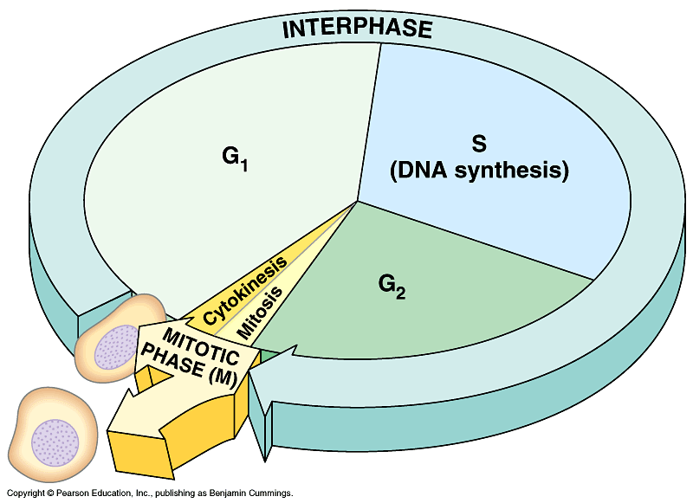
Eukaryotic Cell Cycle
An orderly sequence of events in which a cell grows, duplicates its contents and then divides in two
Notes:
In unicellular organisms this produces a new organism
In multicellular organisms long and complex sequences of cell divisions are needed to produce a new organism

Slide 7
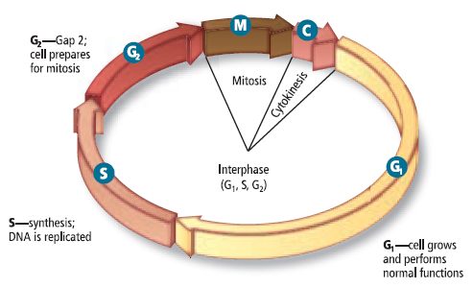
Stages of the Cell Cycle
Interphase
Mitosis
Cytokinesis
Notes:
Other resources divide the cell cycle into 4 stages or phases: G1, S, G2, M-phase (mitosis & cytokinesis)

Slide 8
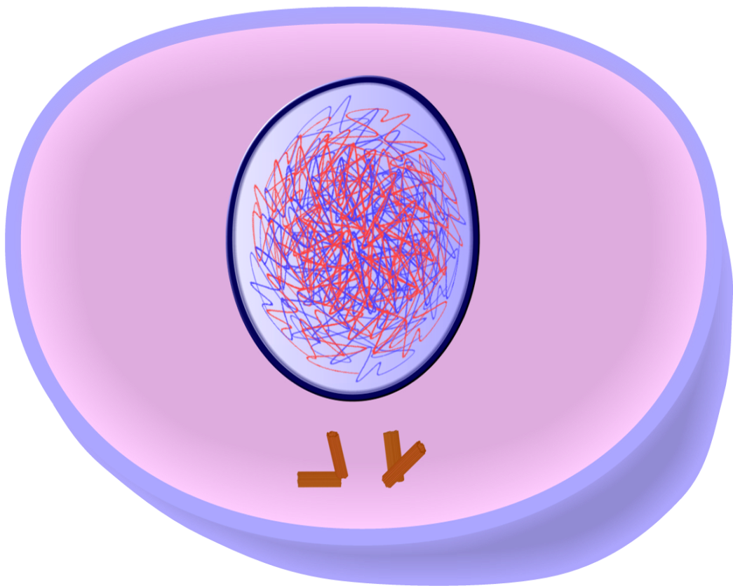
Interphase
During interphase the cell grows, makes organelles and duplicates (copies) its DNA.

Slide 9
Interphase
G1: the cell grows, makes organelles and prepares for S-phase
S-phase “synthesis phase” This is when DNA replication occurs, i.e. the cell copies its DNA
G2 the cell grows, makes organelles and prepares for mitosis and cytokinesis

Slide 10
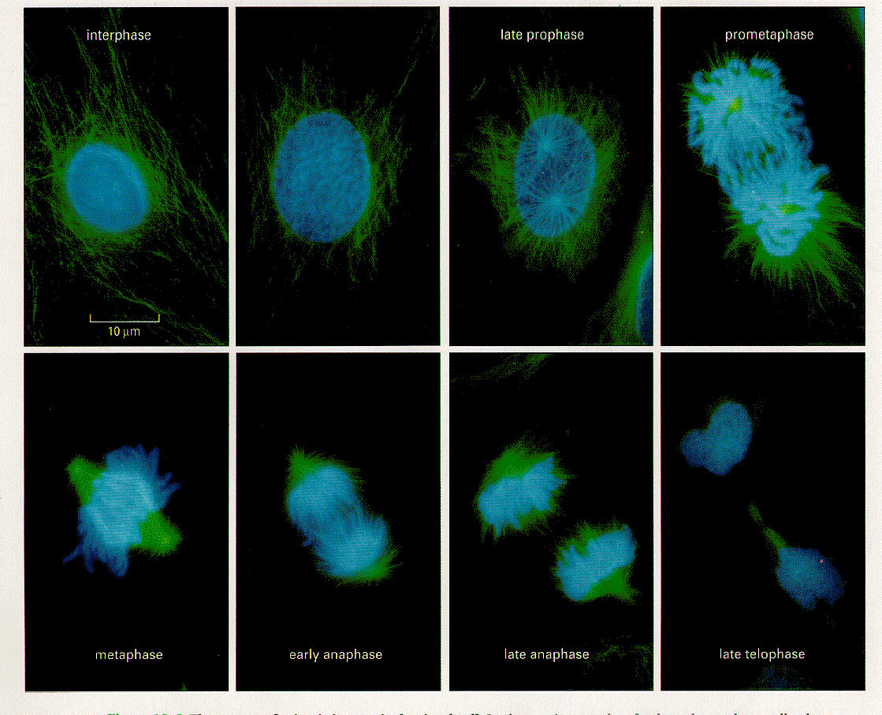
Mitosis:
Division of the nucleus
4 Phases
Prophase
Metaphase
Anaphase
Telophase

Slide 11
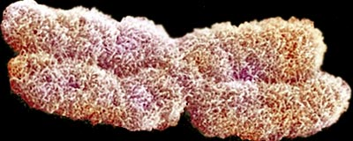
DNA
DNA can be found in one of two forms during the cell cycle: chromatin or chromosome. Both consist of DNA wrapped around proteins
Chromatin is the relaxed or uncondensed form of DNA. In this state, DNA looks like thread or spaghetti
A Chromosome forms when chromatin becomes highly condensed. In this state, DNA looks like a rod or an X (two rods)

Slide 13
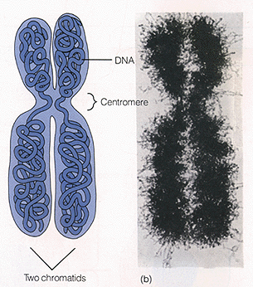

Slide 14
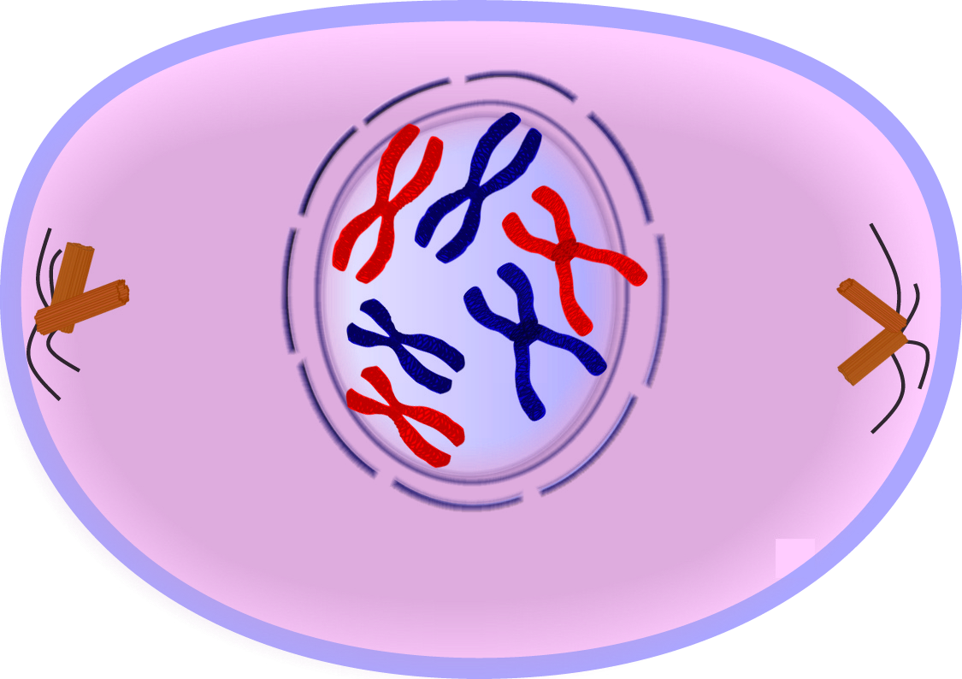
Prophase
Chromatin condenses into chromosomes
The nuclear membrane breaks down
Mitotic spindle begins to form between the poles

Slide 15
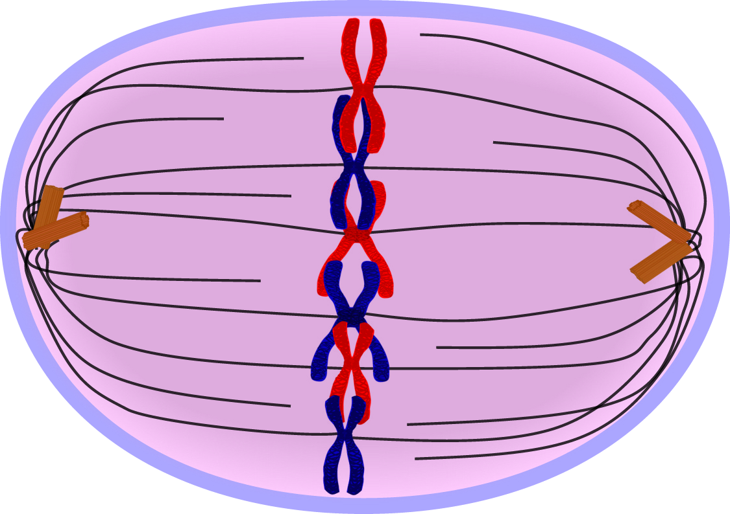
Metaphase
Chromosomes attach to the mitotic spindle and line up along the equator of the cell

Slide 16
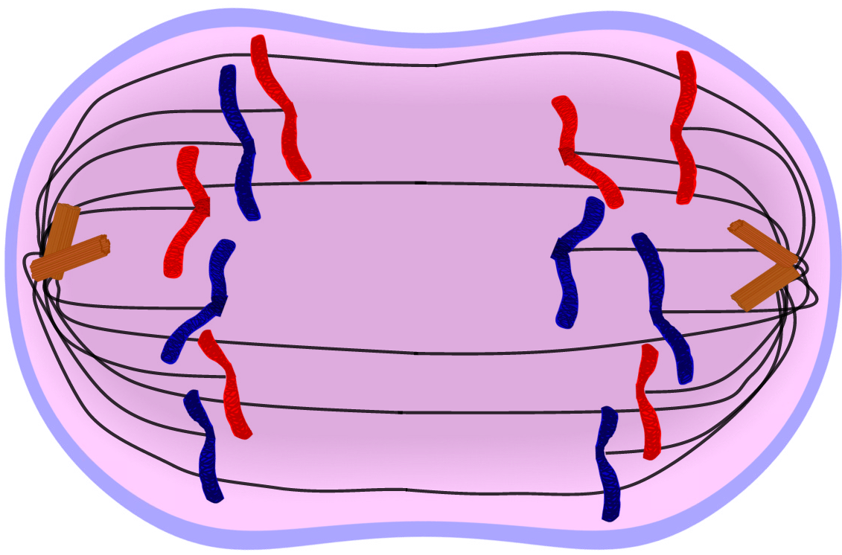
Anaphase
Microtubules of the mitotic spindle shorten, pulling chromosomes to opposite ends of the cell

Slide 17
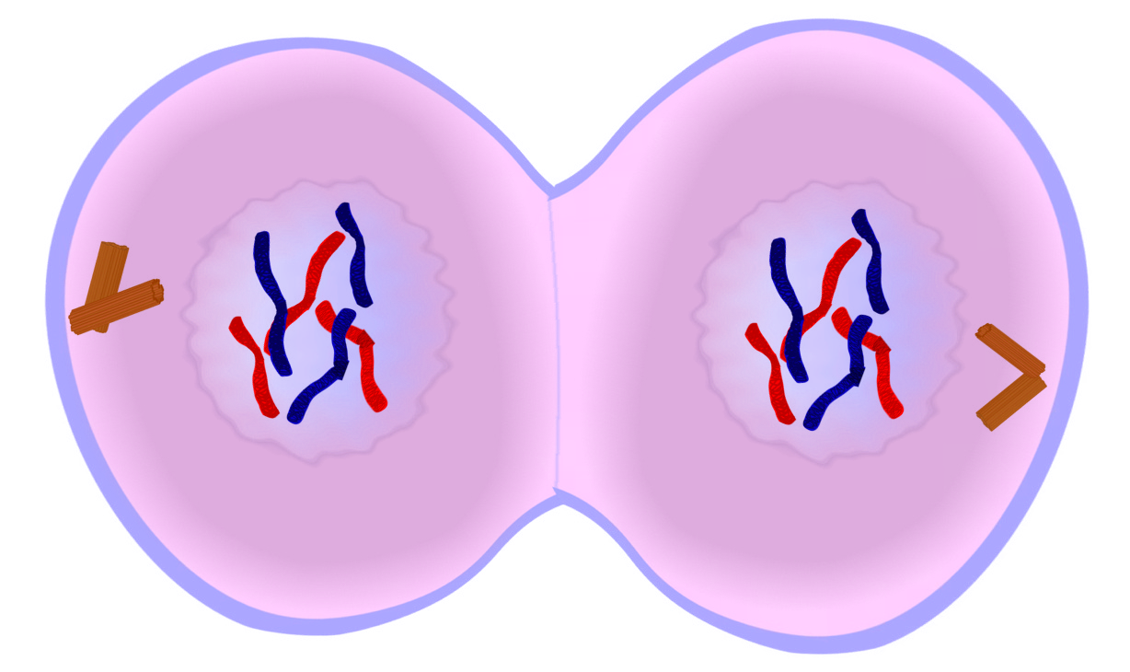
Telophase
Nuclear envelope reforms
Chromosomes decondense
The mitotic spindle is disassembled

Slide 18
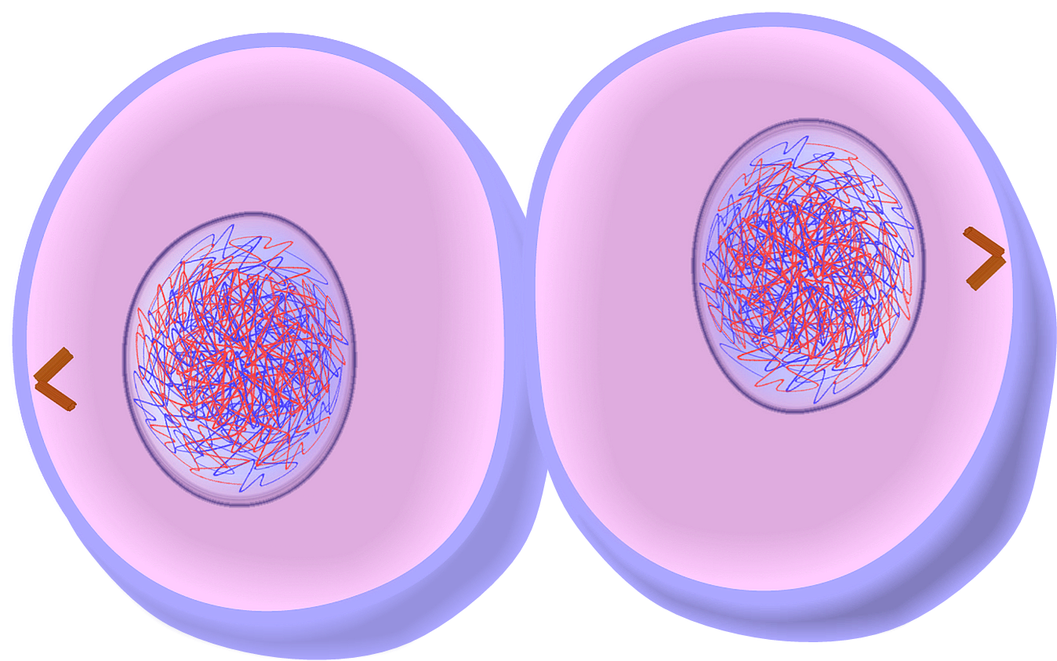
Cytokinesis
Division of the cytoplasm (cytosol & organelles)
In animal cells a cleavage furrow forms along the equator and pinches inward until the cell divides

Slide 19
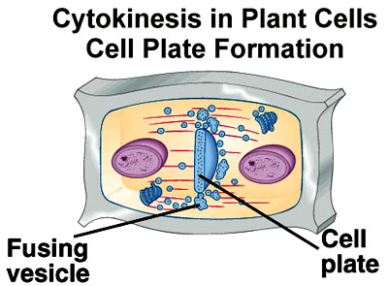
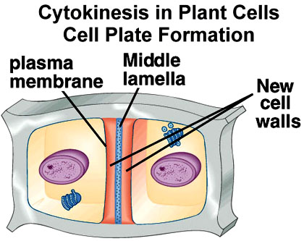

Slide 20
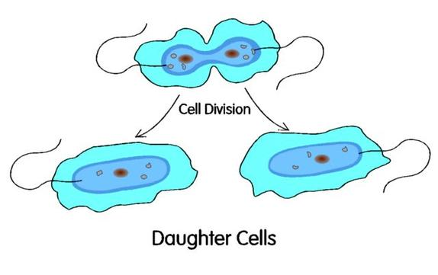
The End Result:
The cell cycle produces two daughter cells that are genetically identically to the parent cell

Slide 21
Asexual Reproduction
Many organisms can reproduce without exchanging genetic material (DNA) with another organism. This is called asexual reproduction.
Very simple organisms like bacteria can reproduce by simply dividing their cell in half in a process called binary fission.
This process does NOT include mitosis; there is no nucleus, chromosomes don’t condense, and no spindle fibers.

Slide 22
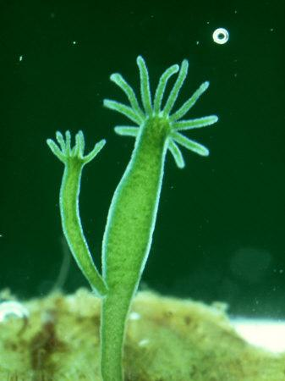
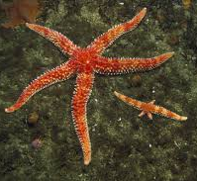
Asexual Reproduction in Animals
Budding: smaller organism begins to grow from adult and detaches when it is mature
Fragmentation: adult organism breaks into smaller pieces, which can each grow into individual organisms.

Slide 23
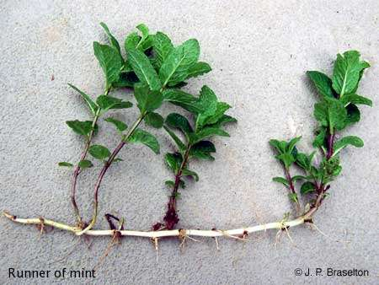
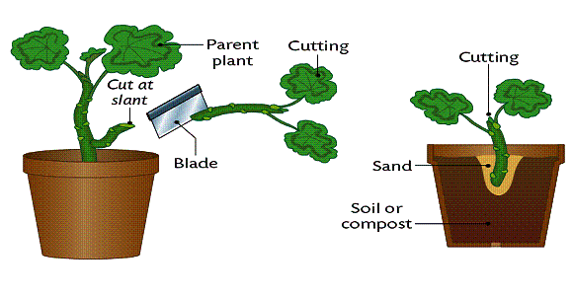
Asexual Reproduction in Plants
Most plants can reproduce asexually using special stems (called “stolons” by biologists and “runners” by gardeners) or by growing from a cutting.

Slide 24
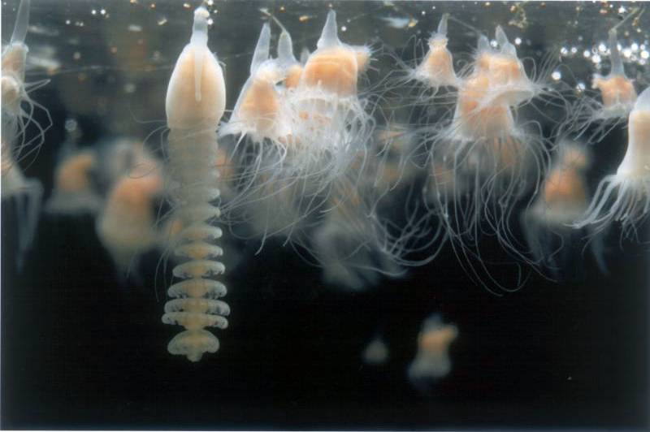
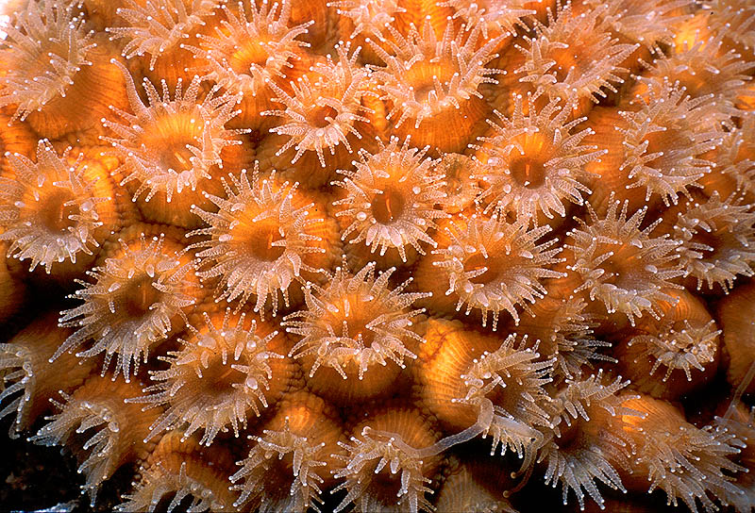
Advantages of Asexual Reproduction
Don’t have to find a mate
Usually a simple process that doesn’t require a lot of resources
Quick process that can produce many offspring

Slide 25
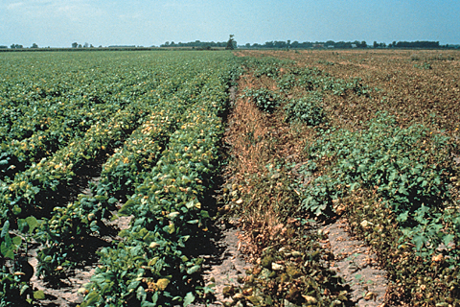
Disadvantage of Asexual Reproduction
Since all offspring are genetically identical to the parent, there is not a wide variety of traits. If there is a change in the environment, it could wipe out the entire population.
Crops with genetic variation may be better able to withstand an attack by pests than a field of genetically identical crops.

