Slide 1
Biological Classification
Chapter 17

Slide 2
Bellringer:
Write down an example of an organization system that you use. How is it helpful?

Slide 3
Standard
  SB3. Students will derive the relationship between single-celled and multi-celled organisms and the increasing complexity of systems.
    b. Compare how structures and function vary between the six kingdoms (archaebacteria, eubacteria, protists, fungi, plants, and animals).
EQ: In what ways do the six kingdoms of living things differ from each other?

Slide 4

Taxonomy
The practice of naming and classifying organisms is called taxonomy.
Taxonomic systems use categories to organize organisms.
The general term for any one of these categories is a taxon (plural, taxa).

Slide 5
Dichotomous Keys
A dichotomous key can be used to identify an unknown organism based on observable characteristics:
  Consists of two part statements that describe characteristics of organisms.
  As the user makes a choice of a characteristic, they are led to a new branch of the key.
For example, let’s consider the Norns on the next page…

Slide 6


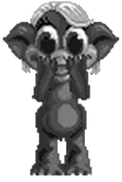





1. Has pointed ears ...................... ............ ........ go to 3
Has rounded ears .................... ............ ..........go to 2
2. Has no tail ............................. ............ ........... Kentuckyus
Has tail ............................ ............ .................. Dakotus
3. Ears point upward ............ ............ ................ go to 5
Ears point downward ........... ............ .............go to 4
4. Engages in waving behavior ......... ............ ... Dallus
Has hairy tufts on ears ....................................Californius
5. Engages in waving behavior ........................... WalaWala
Does not engage in waving behavior ..............go to 6
6. Has hair on head ............................................. Beverlus
Has no hair on head (may have ear tufts) .......go to 7
7. Has a tail .......................................................... Yorkio
Has no tail, aggressive ...................................... Rajus
A
B
C
D
H
G
F
www.biologycorner.com/worksheets/dichoto.html
E

Slide 7
Levels of taxonomy
The eight basic levels of modern classification are
  Domain
  Kingdom
  Phylum
  Class
  Order
  Family
  Genus
  Species
Did
King
Philip
Come
Over
For
Ginger
Snaps?

Slide 8
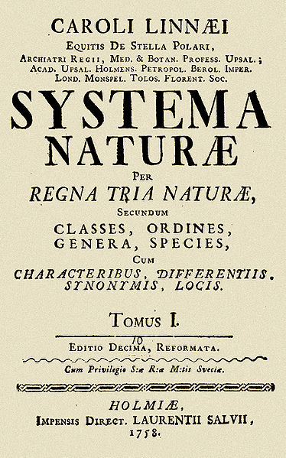
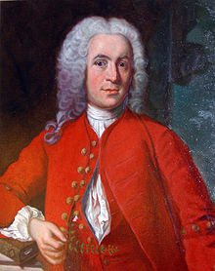
Carl Linnaeus
Swedish scientist who introduced a two-word
naming system called binomial nomenclature.
His system included the genus name and a single descriptive word for each species.
This is an organism’s scientific name.

Slide 9
Rules for Scientific Names
No two species can have the same scientific name.
All scientific names are made up of two Latin or Latin-like (sometimes Greek) terms.
All the members of a genus share the genus name as the first term.
The second term is called the species identifier, and often describes the species.

Slide 10
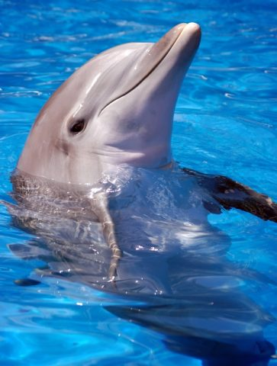
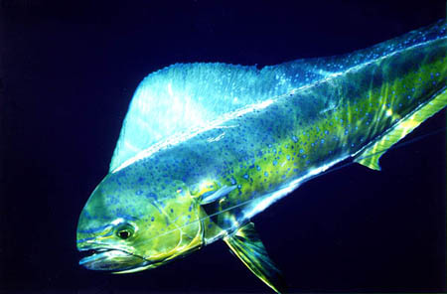
Why do we need scientific names?
“Dolphin” (marine mammal)
“Dolphin” (fish)

Slide 11

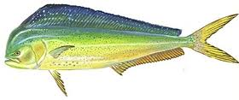
Taxonomy of the “Dolphins”
Bottlenose Dolphin
Mahi Mahi (Dolphin Fish)
DOMAIN: Eukarya
KINGDOM: Animalia
PHYLUM: Chordata
CLASS: Mammalia
ORDER: Cetacea
FAMILY: Delphinidae
GENUS: Tursiops
SPECIES: Tursiops truncatus
DOMAIN: Eukarya
KINGDOM: Animalia
PHYLUM: Chordata
CLASS: Osteichthyes
ORDER: Perciformes
FAMILY: Coryphaenidae
GENUS: Coryphaena
SPECIES: Coryphaena hippurus

Slide 12
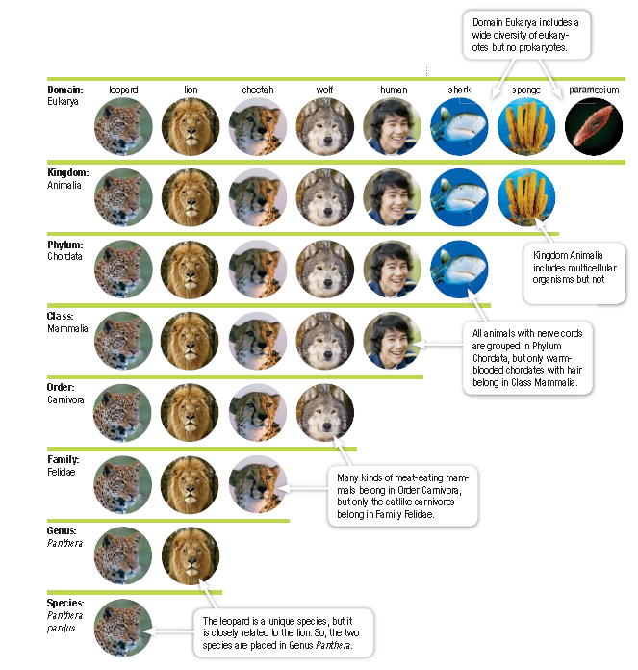

Slide 13
The Six Kingdoms of Life
Domain Bacteria: all organisms in this domain are prokaryotic
  Kingdom Eubacteria
Domain Archaea: all organisms in this domain are prokaryotic
  Kingdom Archaebacteria
Domain Eukarya: all organisms in this domain are eukaryotic
  Kingdoms include Protista, Fungi, Plantae, Animalia

Slide 14
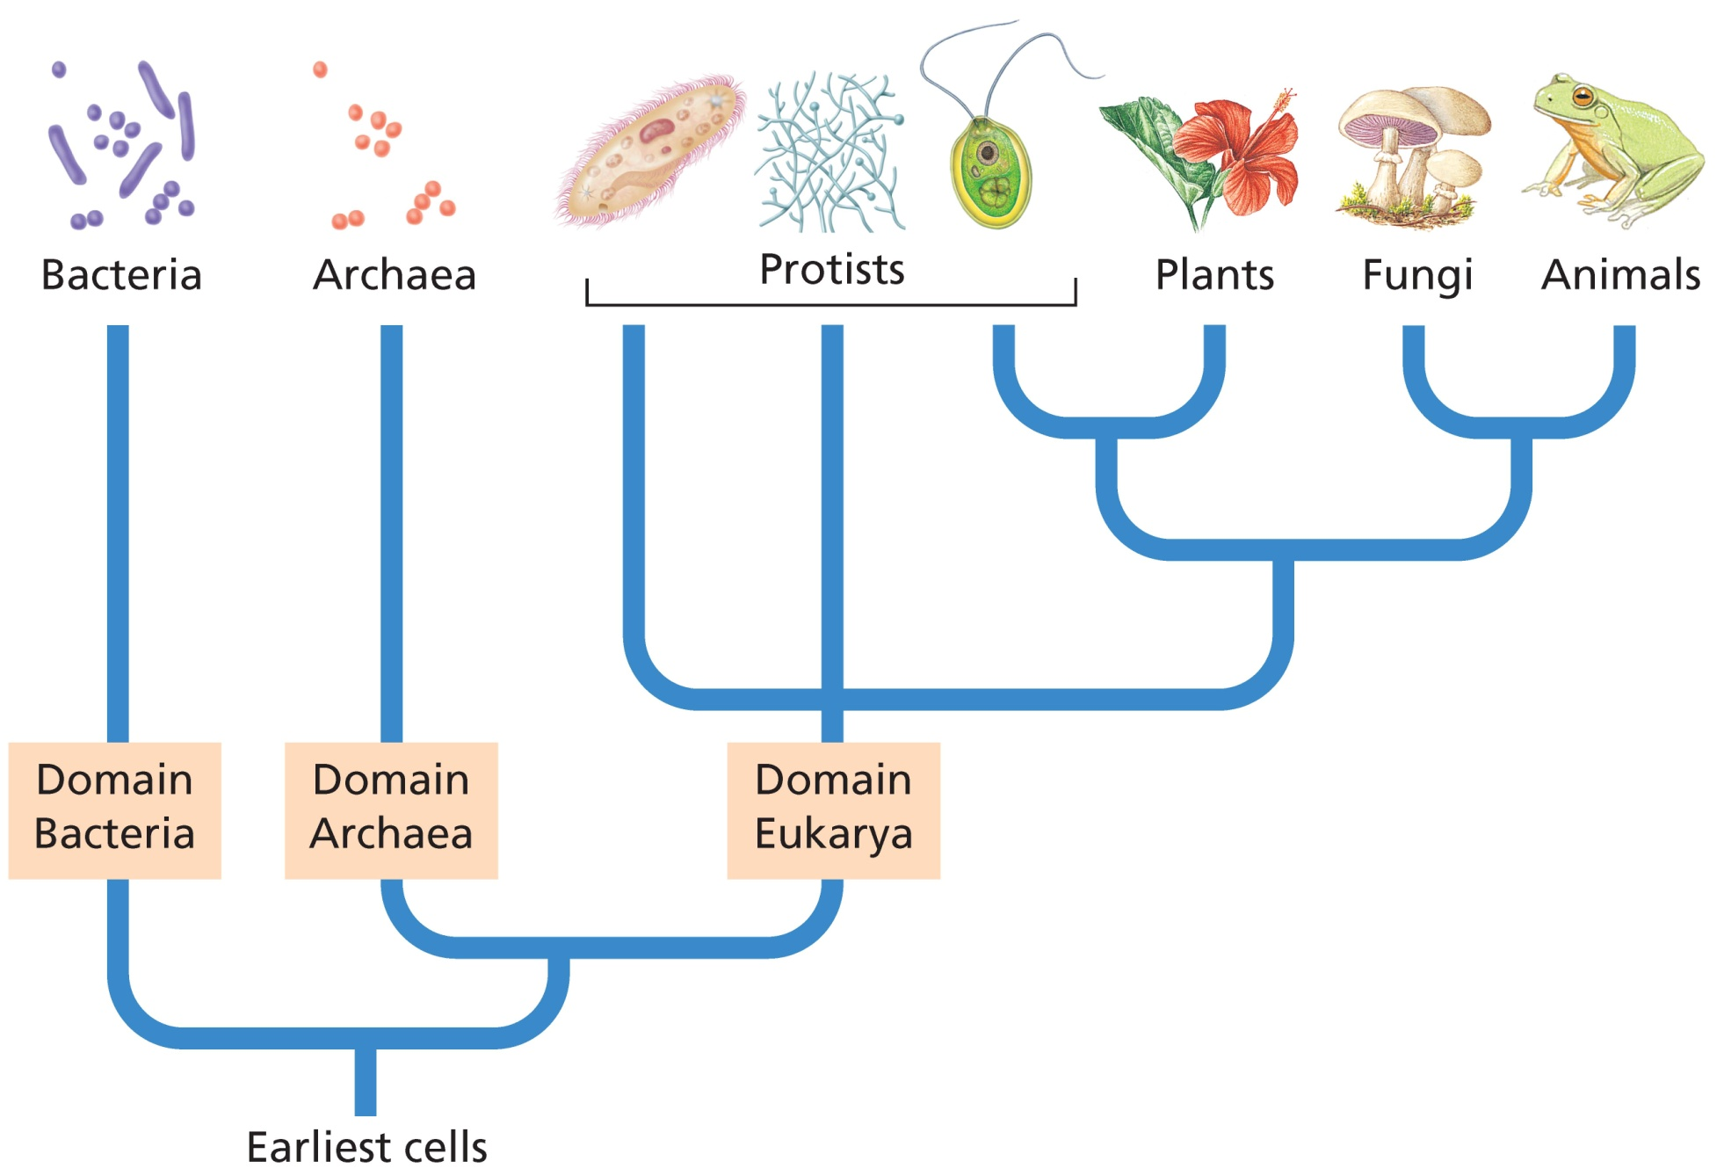

Slide 15
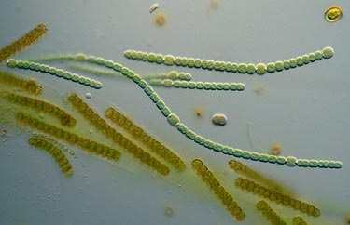
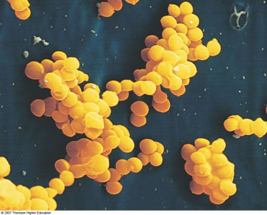
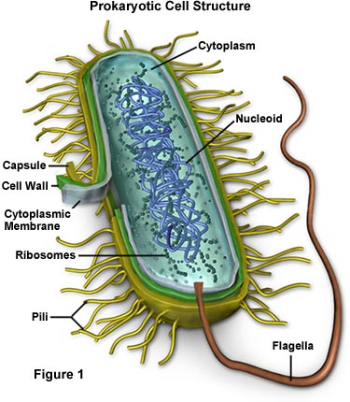
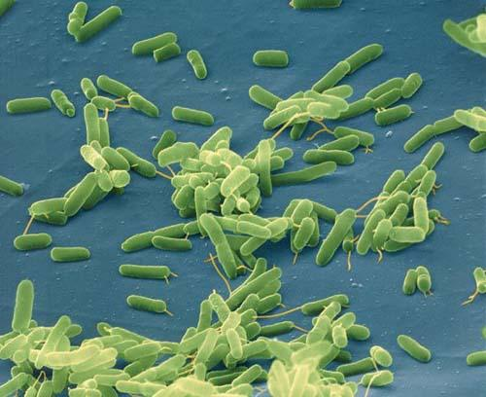
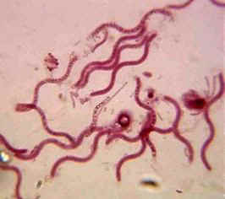
Domain Bacteria, Kingdom Eubacteria

Slide 16
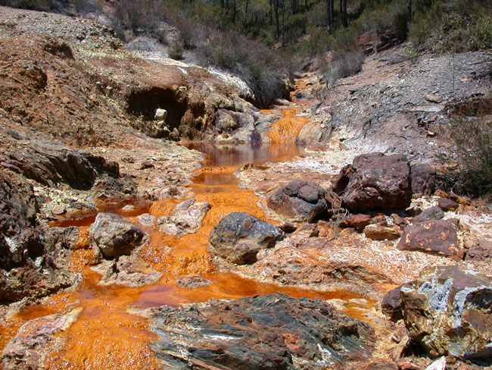
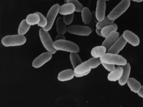
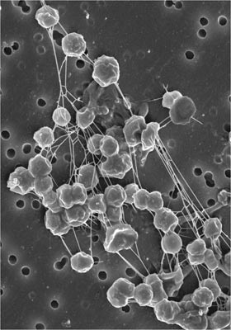
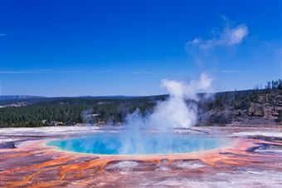
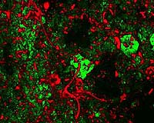
Domain Archaea, Kingdom Archaebacteria

Slide 17
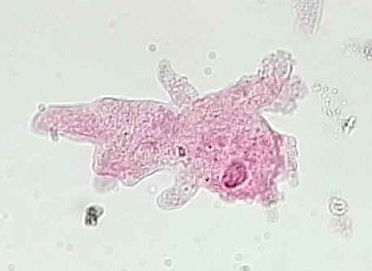
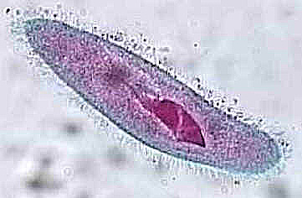
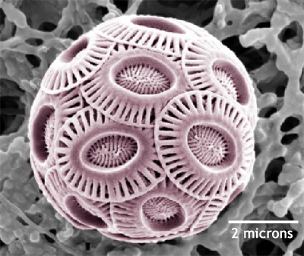
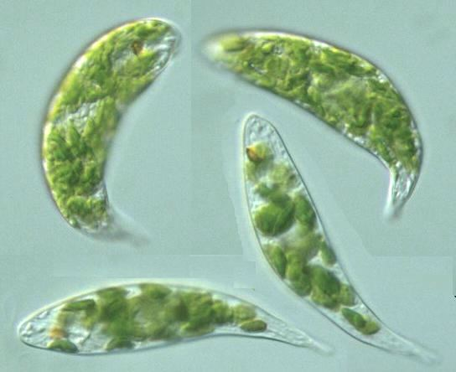
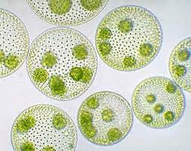
Domain Eukarya, Kingdom Protista

Slide 18
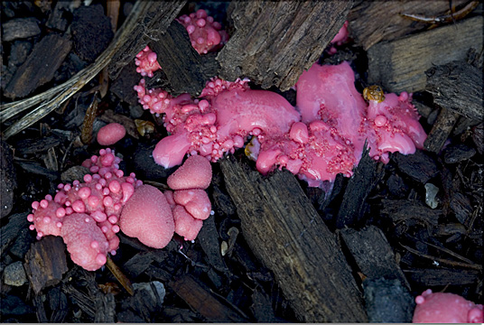
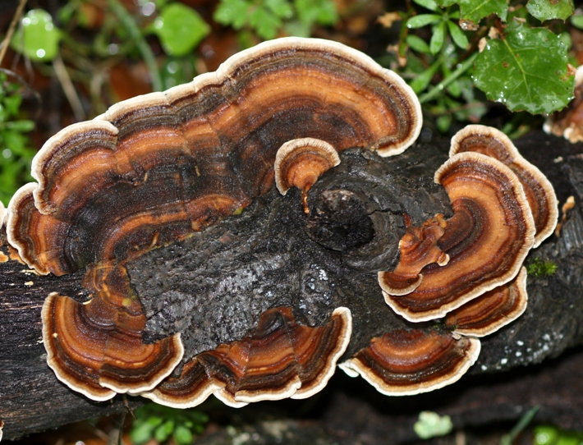
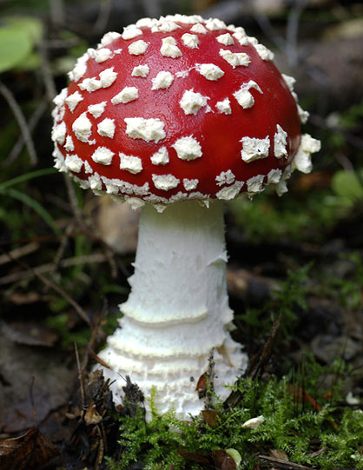
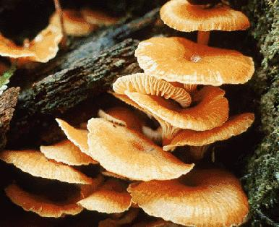
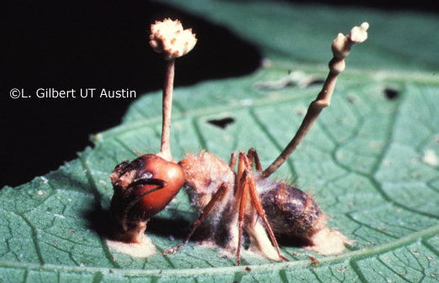
Domain Eukarya, Kingdom Fungi

Slide 19
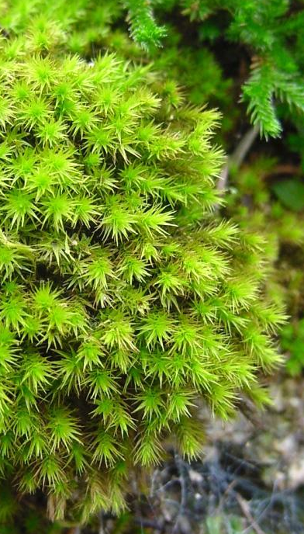

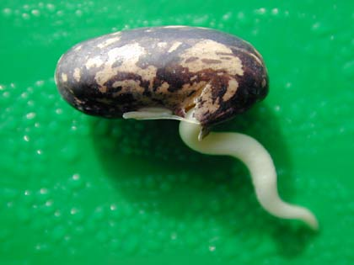

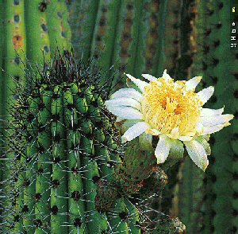

Domain Eukarya, Kingdom Plantae

Slide 20
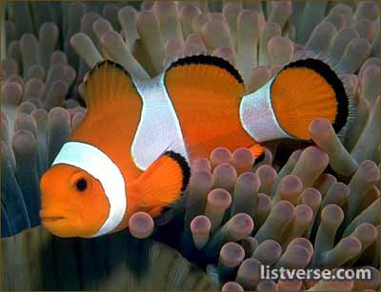
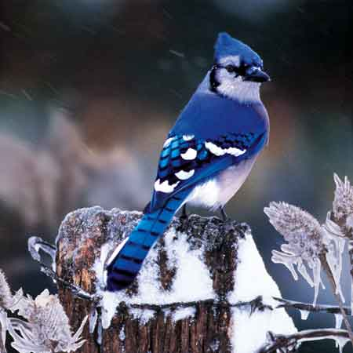
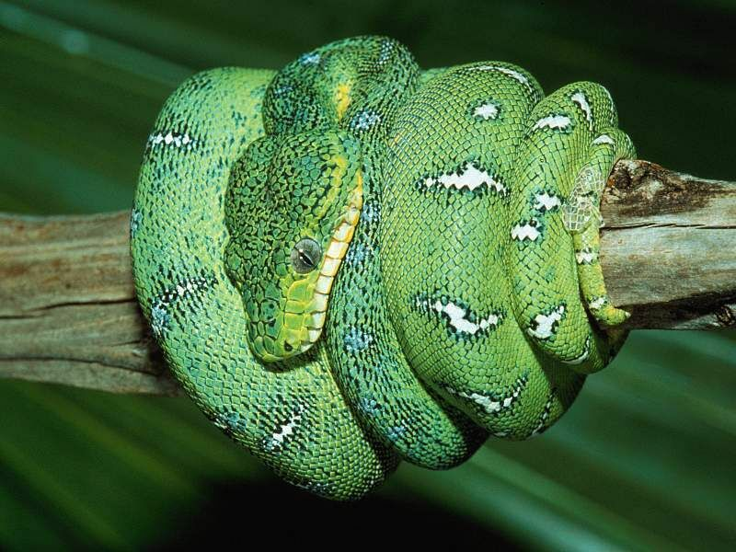

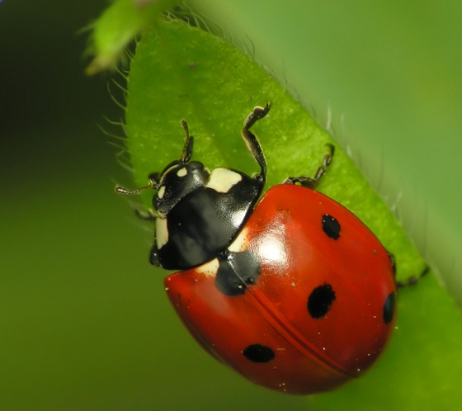
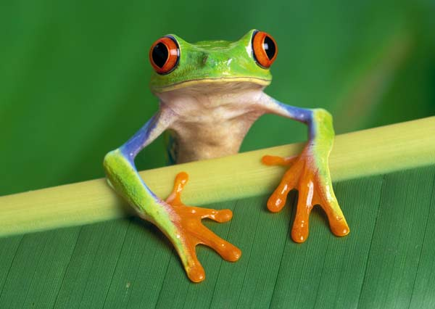
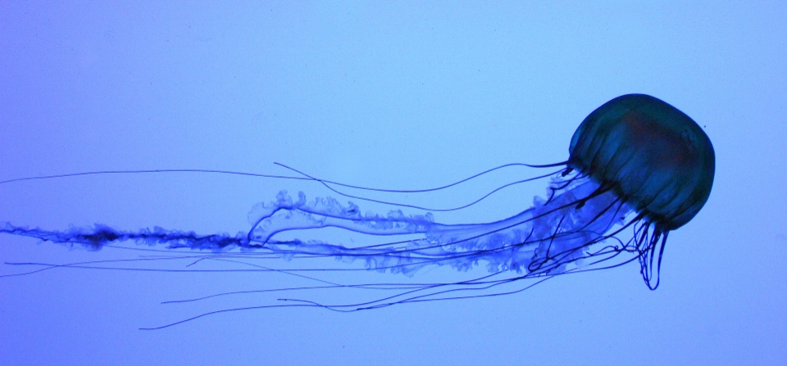
Domain Eukarya, Kingdom Animalia

Slide 21
